Slide 1


lecture two: Introduction to BASIC HTML
Basic syntax, tags, attribute, forms

Slide 2
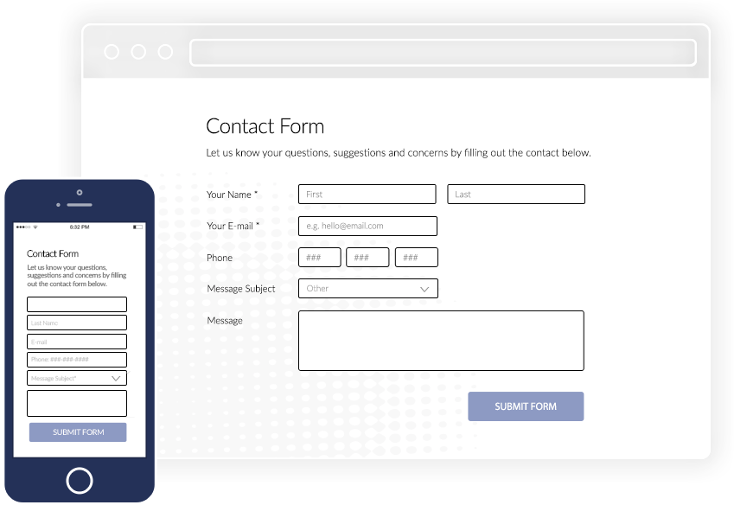
content
Tables
list
Html form: How you can create a form for a user

Slide 3
Html table
It is defined with a table tag:
<table>
<tr>
<th> (table header) Header here….</th> (table header)
<th> (table header) Header here….</th> (table header)
</tr> (table row)
<tr>
<td> (table data or cell) data here….</td> (table data or cell)
<td> (table data or cell) Header here….</td> (table data or cell)
</tr>
</table>

Slide 4
Boarder
<style> table, th, td { border: 1px solid black; border-collapse: collapse; } </style>

Slide 5
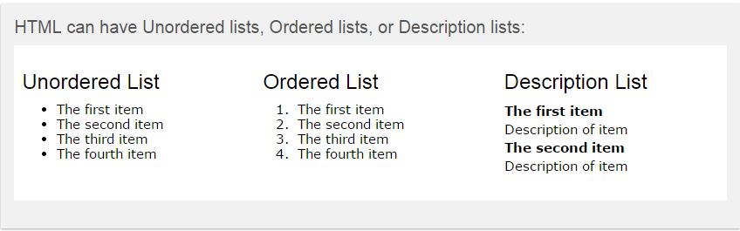
Html LIST
Contents on webpage could be displayed in a list structured (ordered or unordered):

Slide 6
HTML LIST Unordered HTML lists
An unordered list starts with the <ul> tag. Each list item starts with the <li> tag. The list items will be marked with bullets (small black circles).
Unordered list: <ul> <li>coffee</li> <li>tea</li> <li>milk</li> </ul>
It returns disc by default. You can change the styles using attributes such as circle or square

Slide 7
HTML LIST Unordered HTML lists
Unordered HTML lists - the style attribute
A style attribute can be added to an unordered list, to define the style of the marker:
Style description list-style-type:disc the list items will be marked with bullets (default) list-style-type:circle the list items will be marked with circles list-style-type:square the list items will be marked with squares list-style-type:none the list items will not be marked
E.G: <ul style= "list-style-type:square">

Slide 8
HTML LIST Ordered HTML lists
Ordered HTML lists
An ordered list starts with the <ol> tag. Each list item starts with the <li> tag. The list items will be marked with numbers.
Ordered list: <ol> <li>coffee</li> <li>tea</li> <li>milk</li> </ol>
It returns roman numerals by default. You can change the styles using attributes such as ”A” or “a” etc

Slide 9
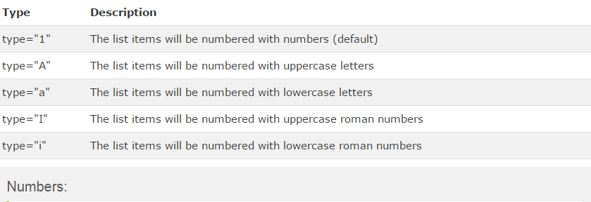
HTML LIST Ordered HTML lists
Ordered HTML Lists - The Type Attribute
A type attribute can be added to an ordered list, to define the type of the marker:
E.G: <ol type=”A">

Slide 10
HTML LIST Description HTML lists
A description list, is a list of terms, with a description of each term. The <dt> tag defines the term (name), and the <dd> tag defines the data (description).
Description list: <dl> <dt>coffee</dt> <dd>- black hot drink</dd> <dt>milk</dt> <dd>- white cold drink</dd> </dl>

Slide 11
HTML FORM
The <form> element
HTML forms are used to collect user input. The <form> element defines an HTML form:
Example <form> . form elements . </form>
HTML forms contain form elements. Form elements are different types of input elements, checkboxes, radio buttons, submit buttons, and more.
Of all, <input > is the most important (it can be used to get info such as name, email address etc)

Slide 12
Html form
The <input> element
The <input> element is the most important form element. The <input> element has many variations, depending on the type attribute. Here are the types used in this chapter:
Type description text defines normal text input radio defines radio button input (for selecting one of many choices) submit defines a submit button (for submitting the form)

Slide 13
Html form Text input
Text input
<Input > defines a one-line input field for text input:
Example <form> first name:<br> <input type="text" name="firstname"> <br> last name:<br> <input type="text" name="lastname">
<button> Submit </button> </form>
Other input types: email, password, file, radio (to choose an option), checkbox

Slide 14
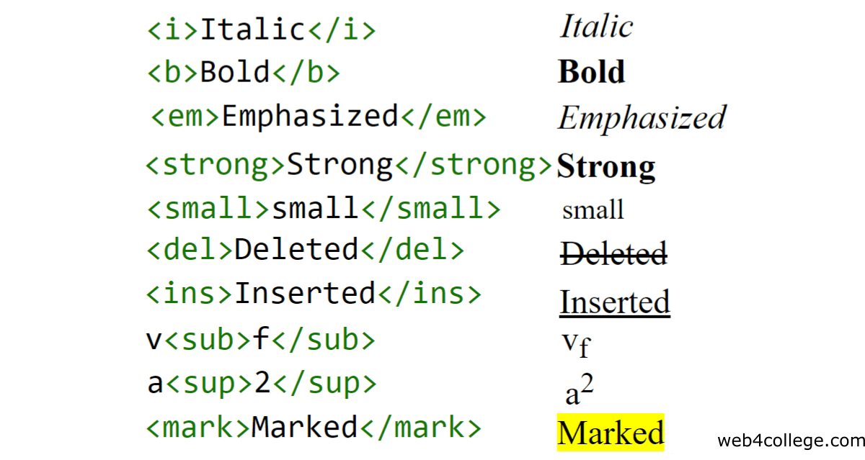
HTML FORMATTING
Special html that we use to define special meaning e.g bold, italics, subscript, superscript

